Slide 1
Segmentation and Clustering of Chandigarh City
Battle of the Neighborhoods

Slide 2
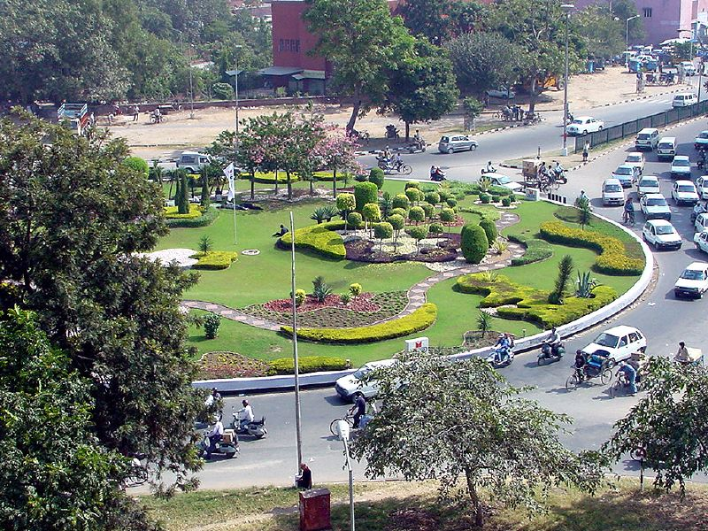
A.BACKGROUND & Problem Statement OF THE CITY UNDER ANALYSIS
Chandigarh is a city and a union territory in India that serves as the capital of the two neighbouring states of Punjab and Haryana. The city is unique as it is not a part of either of the two states but is governed directly by the Union Government, which administers all such territories in the country.
Problem Statement:
The People moving into Chandigarh would better insights of what to expect from the City in terms of quality of life and what Neighborhoods they could choose to live in
Target Audience: Any body who is looking to relocate to the City Beautiful
This Photo by Unknown Author is licensed under CC BY-NC-ND

Slide 3
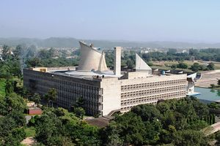
Data acquisition and cleaning
‘pageocode’ has been used for getting the ‘GPS coordinates’, ‘region name’ and municipality name from postal codes
The City Consists of 28 Regions and 12 column types
The Data had to be cleansed for non available fields and a sub Dataframe was created to get most relevant columns for analysis
Unique Neighborhoods were superimposed on the Chandigarh map
This Photo by Unknown Author is licensed under CC BY-SA

Slide 4
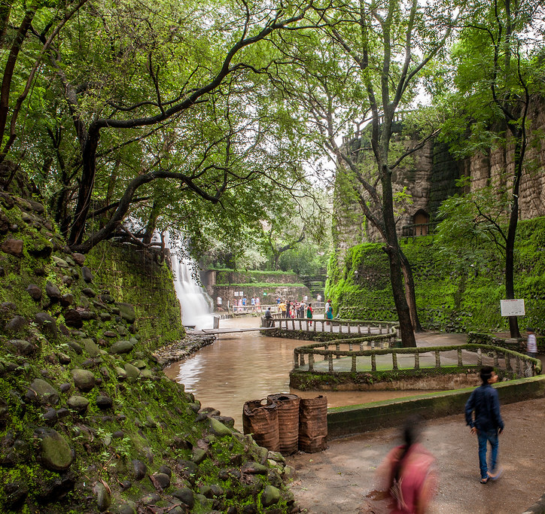
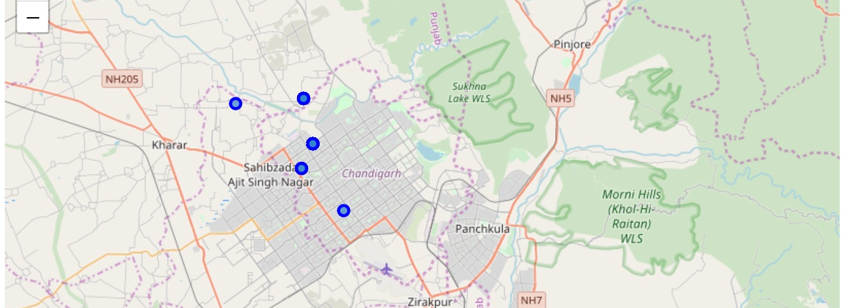
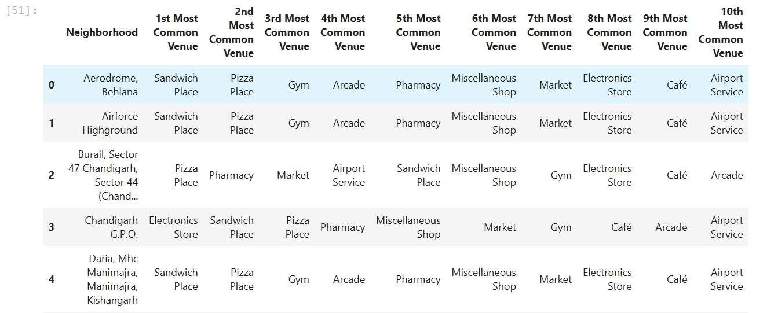
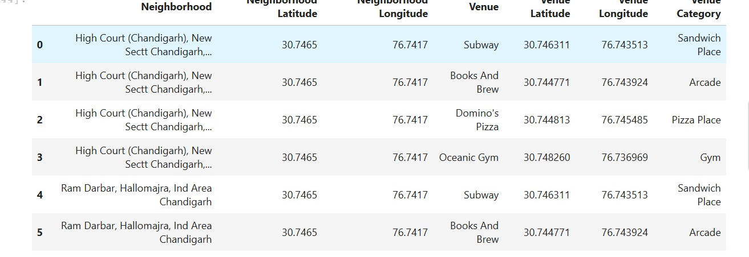
Explore Neighbourhoods & Venues in Chandigarh
This Photo by Unknown Author is licensed under CC BY-NC-ND

Slide 5
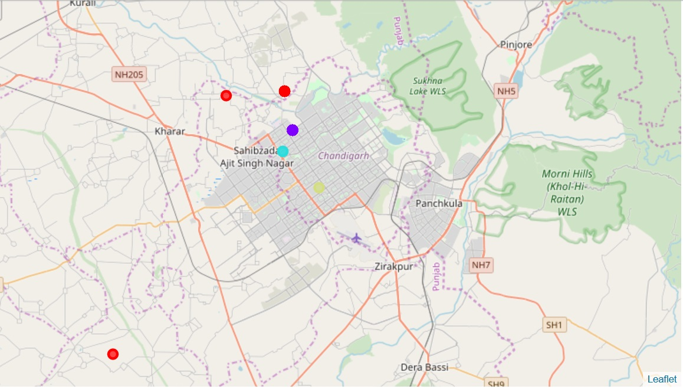
Clustering of Neighbourhoods using K-Squares Method (Unsupervised Machine Learning)
Key: Yellow- Cluster3, Red :Cluster0, Sky Blue: Cluster2 , Violet: Cluster1
This Photo by Unknown Author is licensed under CC BY-SA

Slide 6
Analysis of Clusters
1: Cluster0 – is primarily areas on the outer skirts of Chandigarh with minimal metropolitan facilities except for Sector 10 and Sector 12 (Having Punjab Engineering College). The outer skirts have manufacturing units. There are about 15 medium to large industries including two in the public sector. In addition, Chandigarh has over 2,500 units registered under small-scale sector. The important industries are paper manufacturing, basic metals and alloys, and machinery. Other industries are relating to food products, sanitary ware, auto parts, machine tools, pharmaceuticals, and electrical appliances.
2:Cluster1- Contains
Four major trade promotion organisations have their offices in Chandigarh.
Chandigarh IT Park (also known as Rajiv Gandhi Chandigarh Technology Park)
There are numerous educational institutions in Chandigarh.
These range from privately and publicly operated schools to colleges and the Panjab University.
Other Institutions are Post Graduate Institute of Medical Education and Research (PGIMER), Government Medical College and Hospital, Punjab Engineering College Deemed University, Government College for Men, Government College for Women, DAV College, MCM DAV College for Women, Goswami Ganesh Dutta Sanatan Dharma College Sector-32, Government Homeopathic College, Ayurvedic College, Government Polytechnical College, Government Home Science College, Dr. Ambedkar Institute of Hotel management, Khalsa College Sec- 26, National Institute of Technical Teachers Training and Research (NITTTR) Sec-26, Government College of Commerce and Business Administration (GCCBA) Sec-50 etc.
According to Chandigarh administration's department of education, there are a total of 115 government schools in Chandigarh
3. Cluster 3 & Cluster 2 have a mix of Government offices and schools
Electronics Store
Sandwhich Place
Pizza Place
Pharmacy
Misc Shops
Primarily
Non Metro Crowd
Sandwhich Place
Pizza Place
GYMN
Arcade
Pharmacy
Misc Shops
Young College
/IT Sector
Population that is
Fond of fast food
And also health
Conscious fond of
Gymns
Misc Shops
Café
ATM
Mixed Population
This Photo by Unknown Author is licensed under
This Photo by Unknown Author is licensed under CC BY-SA

Slide 7
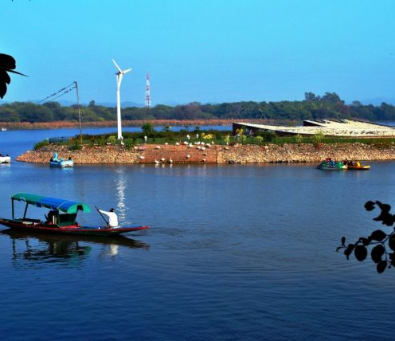
Recommendations
The quality of living in the City is very high. With good living facilities and good mix of Shopping facilities/ Educational institutes/Gym facilities with well spread network of quick bite joints catering to the young college population…Cluster1
Also a very good city for retired population with well spread network of hospitals/ Parks and pharmacies.
This report offers a comprehensive view of Chandigarh City giving a fairly good insights of what People moving into the City could expect
This Photo by Unknown Author is licensed under CC BY-ND

